Slide 1
I have been learning about:

Slide 2
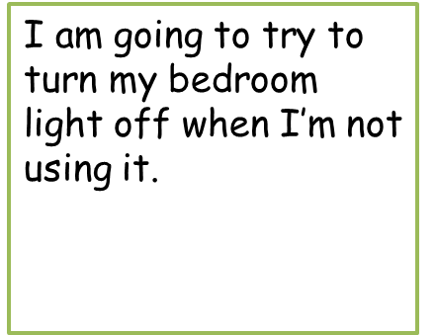
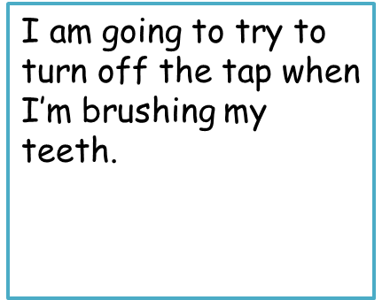
To be a super hero…
www.the-learning-curve.org.uk

