Slide 1
This presentation shows Youtube clips to demonstrate the strength of the sun, water and wind.
Suggest they are shown with no sound
Note: there are some comments written about the clips that are not suitable for a child to see
Suggested length of clip to be shown is stated
Please check clips prior to showing

Slide 2
How Powerful is the Sun?
Click on the frying pan to watch
N.B. Suggest watching to 1m 17sec

Slide 3
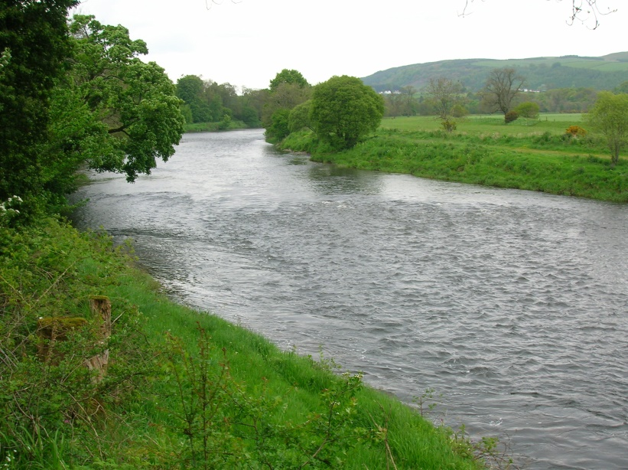
How Powerful is the Water?
Click on the river to watch
N.B. Suggest watching to 17sec

Slide 4
How Powerful is the Wind?
Click on the windy cloud
N.B. Suggest watching full clip

