Slide 1
Super Sun

Slide 2
Wonderful Water

Slide 3
Wooshing Wind

Slide 4
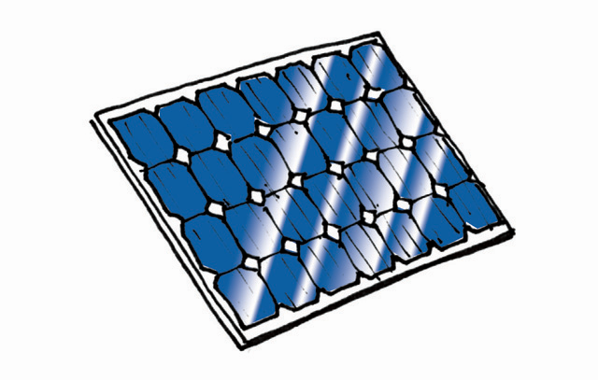
Solar Panel

Slide 5
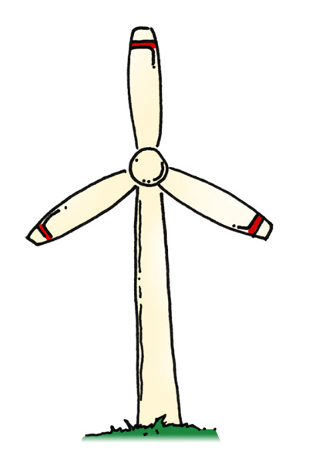
Wind Turbine

Slide 6
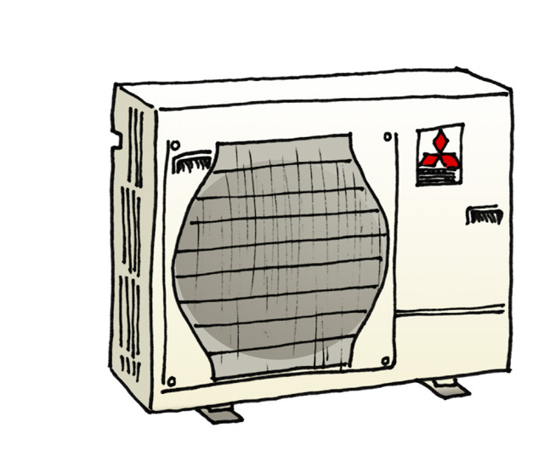
Heat Pump

